Slide 1
Verification of a Flight Ready Hybrid Rocket Motor
Presenter:
Deyzi Ixtabalan
Partner:
Ryan Stoner
Arizona State University

Slide 2
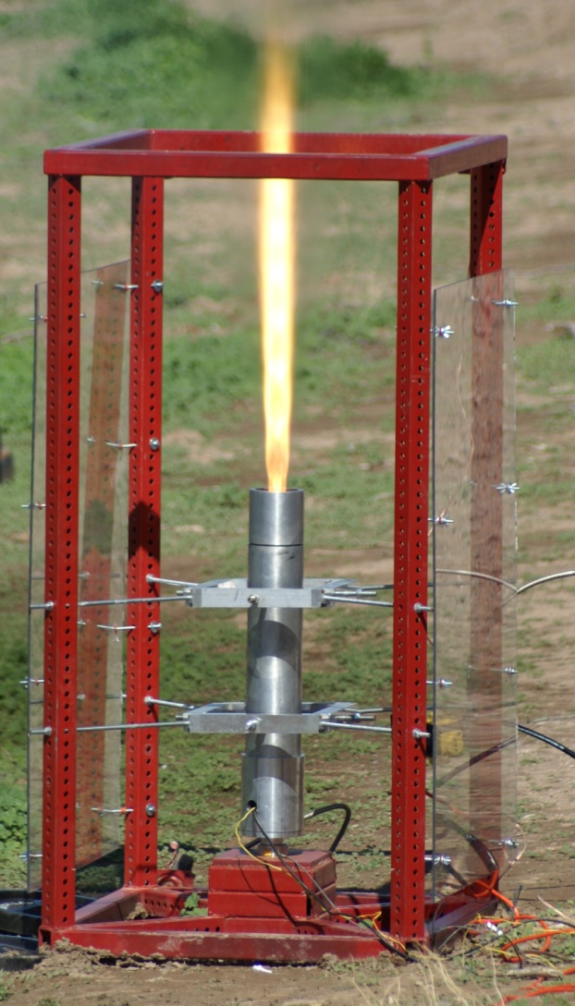
Objectives
Daedalus Astronautics
Basic concept for Hybrid Rockets
Testing
Results

Slide 3
Daedalus Astronautics
A student run rocket club at Arizona State University.
Focused in STEM Outreach
Rockets are made by students and used in competitions.

Slide 4
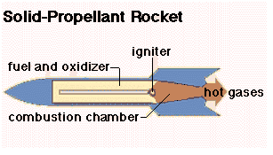
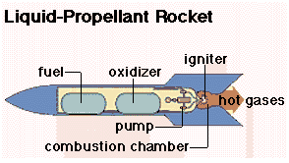
Types of Rockets
Solid Rocket- Solid propellant, lower Isp
Liquids Rockets- Liquid propellant, high Isp,
Hybrids Rockets-Mixture of both
Pictures from
http://www.unb.ca/transpo/mynet/engines.htm
Notes:
Isp: Specific impulse, measurement of efficiency.

Slide 5
Basic Concept
Hybrid Rockets consist of a solid and liquid propellant stored in separate tanks.
Used Hydroxyl-terminated polybutadiene (HTPB) and nitrous oxide (NO2)
Notes:
HTPB is a polymer. Using a curative(harderner), black power.

Slide 6
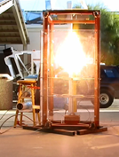
Testing
Test stand is covered with plexiglass for protection
Load Cell- Force from combustion chamber
2 Pressure transducer- at combustion chamber and oxidizer tank

Slide 7
Video of 1st Static Test

Slide 8
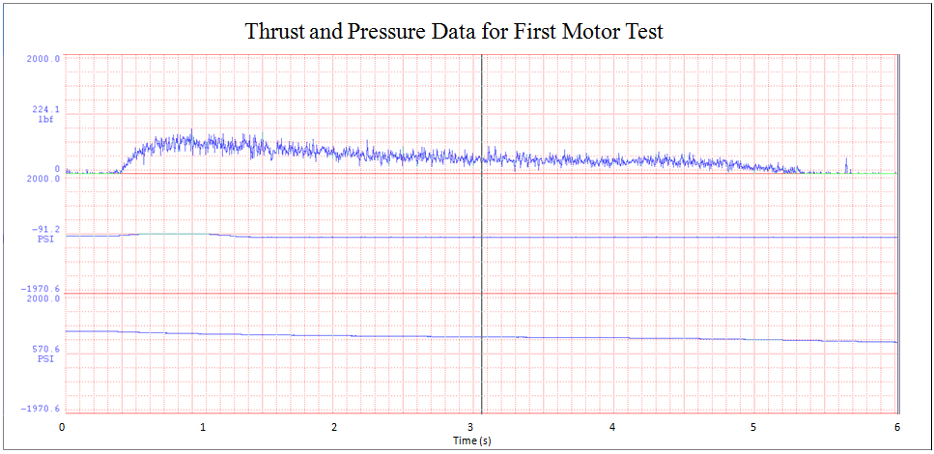
Results
Average thrust average ~263lb
Enough to be used as a flight motor
Notes:
Oxidizer tank maintained a fairly constant mass flow rate through out the burn
Actual average thrust is very close to the desired value
The burn time was half that of the desired value
The motor produces enough thrust to be used as a flight motor

Slide 9
Acknowledgements
Special Thanks to:
Advisor: Matt Summers
NASA/ASU Space Grant Program

